Slide 1


Alan Bracamonte
March / 2025

Slide 2

Outline
Executive Summary
Introduction
Methodology
Results
Conclusion
Appendix

Slide 3
Executive Summary
Methodologies
1. Data Collection using API
2. Data Collection with Web Scraping
3. Data Wrangling
4. Exploratory Data Analysis with SQL
5. Exploratory Data Analysis with Data Visualization
6. Interactive Visual Analytics with Folium
7. Prediction using Machine Learning
Results
Exploratory Data Analysis
Predictive Analytics from Machine Learning models

Slide 4
Introduction
About the project
Companies like SpaceX, Blue Origin, and Virgin Galactic are making space travel affordable. So, the objective of this project is use machine learning and SpaceX data to help Space Y (a fictitious competitor of SpaceX) optimize pricing and compete effectively.
Key Questions
How does first stage landing impact launch costs?
Can ML models predict first stage landing success?
What insights can help Space Y compete with SpaceX?

Slide 5

Section 1

Slide 6
Methodology
Executive Summary
Data collection methodology:
First with SpaceX API and then with web scraping
Perform data wrangling
Handling the missing values
Perform exploratory data analysis (EDA) using visualization and SQL
Perform interactive visual analytics using Folium and Plotly Dash
Perform predictive analysis using classification models
How to build, tune, evaluate classification models

Slide 7
Data Collection
Executive Summary
Data Sources
Data Sources:SpaceX API
Data: Launches, rockets, payloads, landing results
Web Scraping
Data Processing
Extraction: GET requests with requests to obtain JSON
Normalization: JSON to DataFrame conversion with json_normalize
Filtering: Falcon 1 data removal (Falcon 9 only)
Cleaning
Replacing null values in PayloadMass with the mean
Outcome coding in binary classes (0: failure, 1: success)
Objective: Create a clean dataset to predict rocket landing attempts.

Slide 8
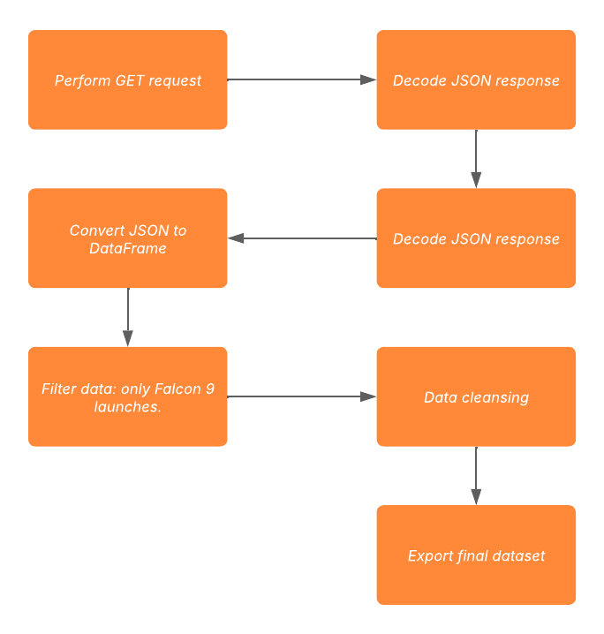
Data Collection – SpaceX API
Source: Data collected from SpaceX API: https://api.spacexdata.com/v4/rockets/
Scope: Focused on Falcon 9 launches.
Process:
Made a GET request to fetch data.
Decoded JSON response and converted to a Pandas DataFrame using json_normalize().
Data Cleaning:
Identified and handled missing values.
Filled missing values with column means.
Final Dataset: 90 rows and 17 columns
GitHub: API

Slide 9
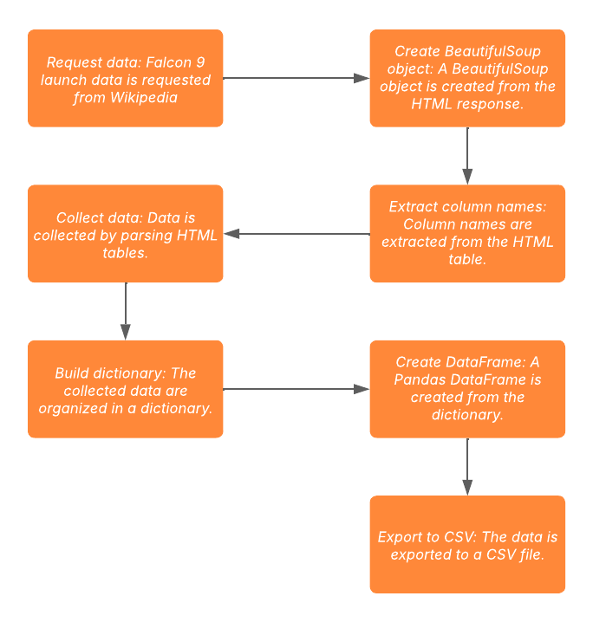
Data Collection - Scraping
Source: Data scraped from Wikipedia: https://en.wikipedia.org/wiki/List_of_Falcon_9_and_Falcon_Heavy_launches
Scope: Focused on Falcon 9 launches.
Process:
Used BeautifulSoup to extract launch records from HTML tables.
Parsed and converted the data into a Pandas DataFrame.
Final Dataset: 121 rows and 11 columns
GitHub: Scraping

Slide 10
Data Wrangling
Data wrangling with the objective of cleaning and organize the messy and complex data for easier access and analysis.
Calculate the number of launches per site.
Determine mission outcome frequencies by orbit type.
Create a landing outcome label:
"1" = Successful booster landing.
"0" = Unsuccessful landing.
4. Final Step: Export cleaned and processed data to a CSV file.
GitHub: Wrangling

Slide 11
EDA with Data Visualization
Objective: Identify relationships between attributes to understand factors affecting landing success.
Scatter Plots Used:
Payload vs. Flight Number
Flight Number vs. Launch Site
Payload vs. Launch Site
Flight Number vs. Orbit Type
Payload vs. Orbit Type
Purpose: Identified dependencies and patterns to determine factors affecting landing success.
Outcome: Strong relationships identified can be used as valuable features in machine learning models.
GitHub: EDA Data Visualization

Slide 12
EDA with Data Visualization
Bar Charts
Compared discrete categories (e.g., orbit types) to identify success rates.
Visualized relationships between categories and their measured values.
Line Charts:
Revealed trends over time, focusing on yearly launch success rates.
Provided insights into how success rates evolved annually.
Feature Engineering
Created dummy variables for categorical columns to prepare data for machine learning models.
GitHub: EDA Data Visualization

Slide 13
EDA with SQL
Queries Performed
Unique launch site names.
5 records where launch sites start with ‘CCA’.
Total payload mass carried by NASA (CRS) boosters.
Average payload mass for booster version F9 v1.1.
Date of first successful ground pad landing.
Boosters with successful drone ship landings and payload mass between 4000 and 6000.
Total successful and failed mission outcomes.
Booster versions with maximum payload mass.
Failed drone ship landings in 2015 (booster versions and launch sites).
Ranking of landing outcomes (success/failure) between 2010-06-04 and 2017-03-20.
Purpose
Gain insights into launch sites, payloads, landing outcomes, and mission success rates.
Identify key patterns and trends for further analysis
GitHub: EDA SQL

Slide 14
Build an Interactive Map with Folium
Interactive Map:
Created using latitude and longitude coordinates for each launch site.
Circle markers labeled with site names.
Colored markers: Green for success, Red for failure.
Grouped markers using MarkerCluster() to assess success rates.
Proximity Analysis:
Calculated distances between launch sites and nearby landmarks (railways, highways, coastlines, cities) using Haversine's formula.
Explored geographical patterns related to launch site locations.
Outcome: Identified geographical trends and success rates across launch sites.
GitHub: Folium

Slide 15
Build a Dashboard with Plotly Dash
Features:
Dropdown to select launch sites.
Pie chart showing:
Total successful launches.
Success vs. failure counts for selected sites.
Slider to filter payload mass range.
Scatter chart to visualize:
Correlation between payload mass and launch success.
Outcomes for different booster versions.
Additional pie charts and scatter graphs for:
Total launches by site.
Relationship between outcome and payload mass.
Purpose:
Enable users to explore and analyze launch data interactively.
Visualize key insights, such as success rates and payload impacts.
GitHub: Dashborad

Slide 16
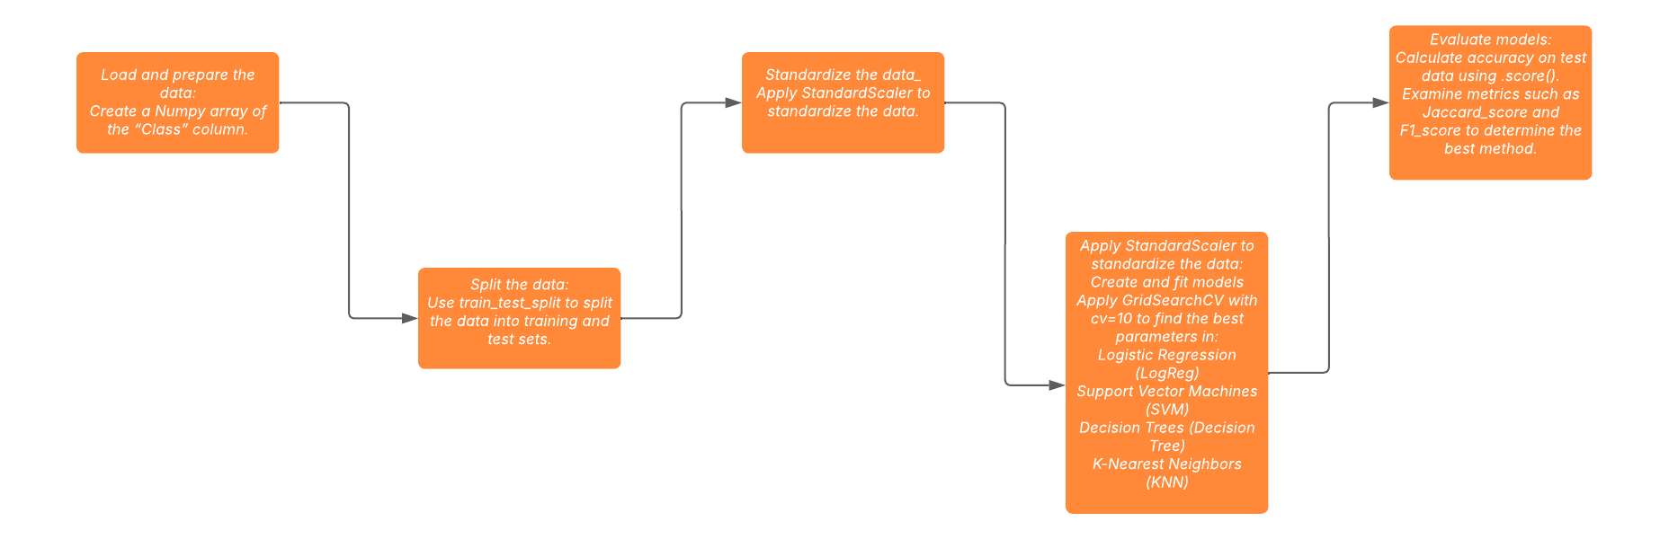
Predictive Analysis (Classification)
Functions from the Scikit-learn library were employed to build our machine learning models:
GitHub: Machine Learning

Slide 17
Results
Exploratory Data Analysis (EDA)
SQL: Data querying and manipulation.
Visualization: Graphical data insights.
Folium: Geospatial data visualization.
Plotly Dash: Interactive data dashboards.
Predictive Analysis: Outcome prediction models.
Note: In all graphs:
Class 0: Failed launch outcome.
Class 1: Successful launch outcome.

Slide 18

Section 2

Slide 19
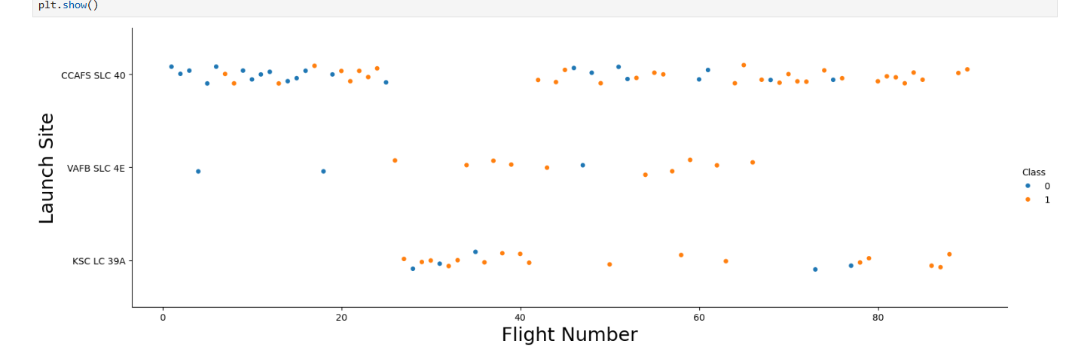
Flight Number vs. Launch Site

Slide 20
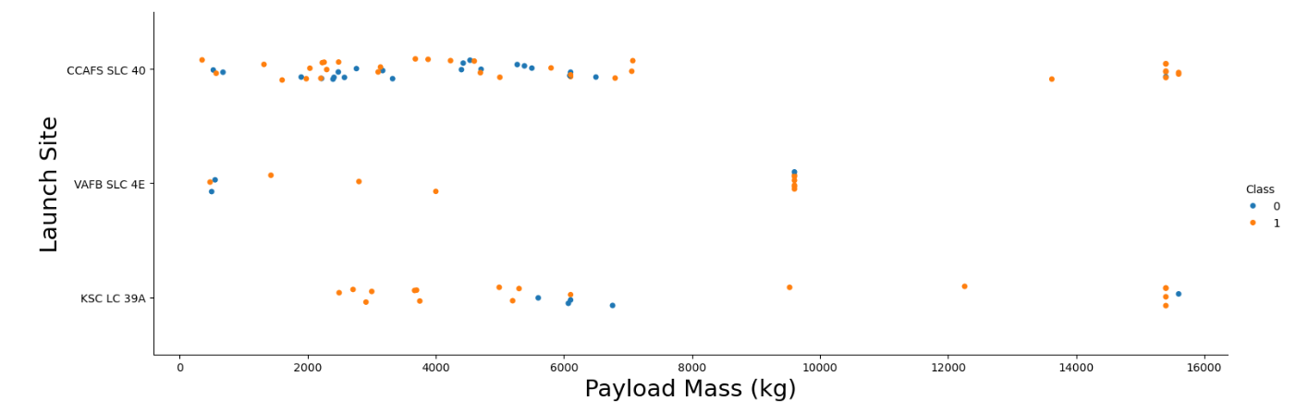
Payload vs. Launch Site

Slide 21
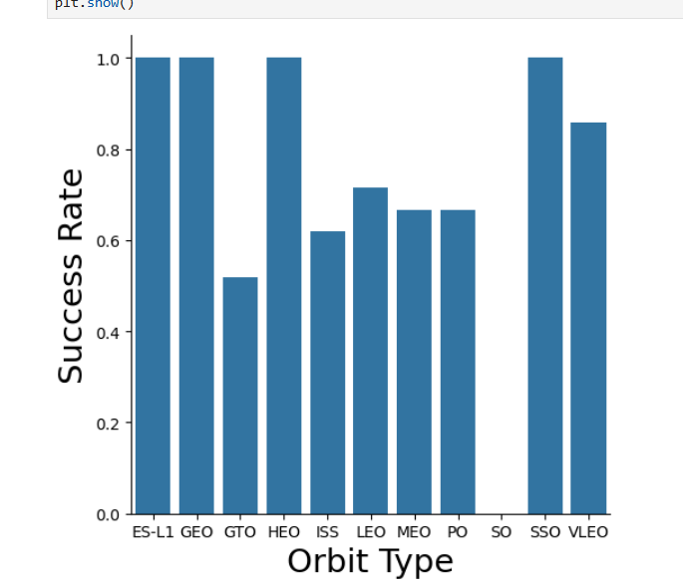
Success Rate vs. Orbit Type

Slide 22
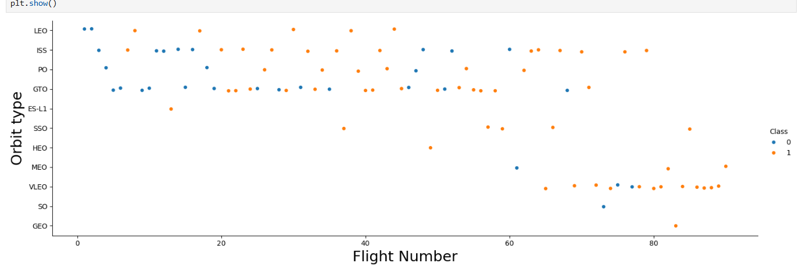
Flight Number vs. Orbit Type

Slide 23
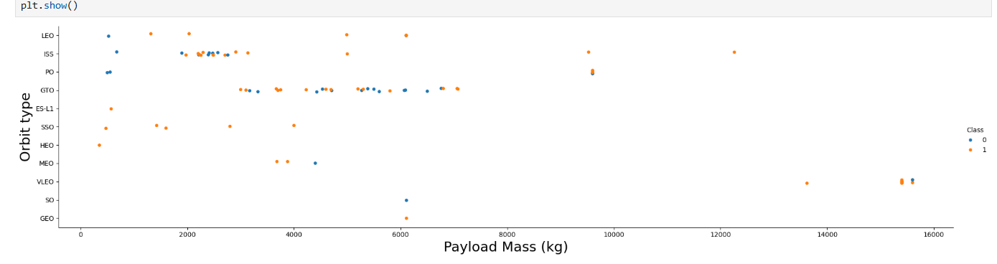
Payload vs. Orbit Type

Slide 24
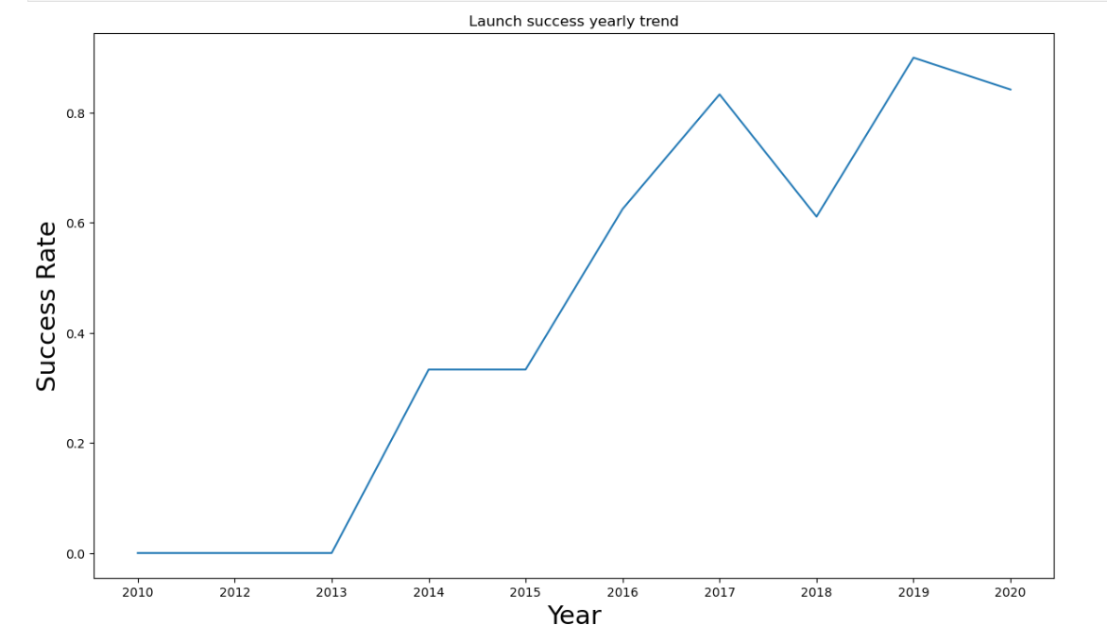
Launch Success Yearly Trend

Slide 25
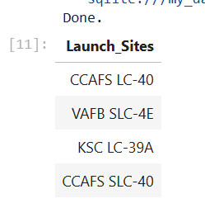
All Launch Site Names

Slide 26
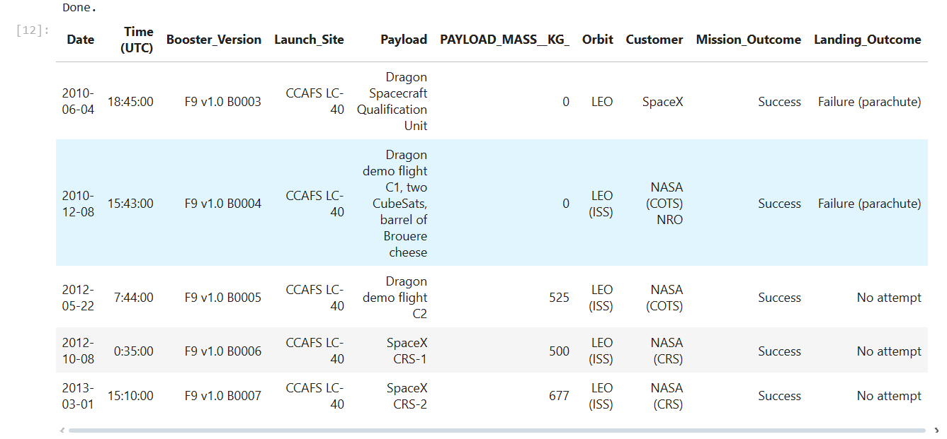
Launch Site Names Begin with 'CCA'

Slide 27
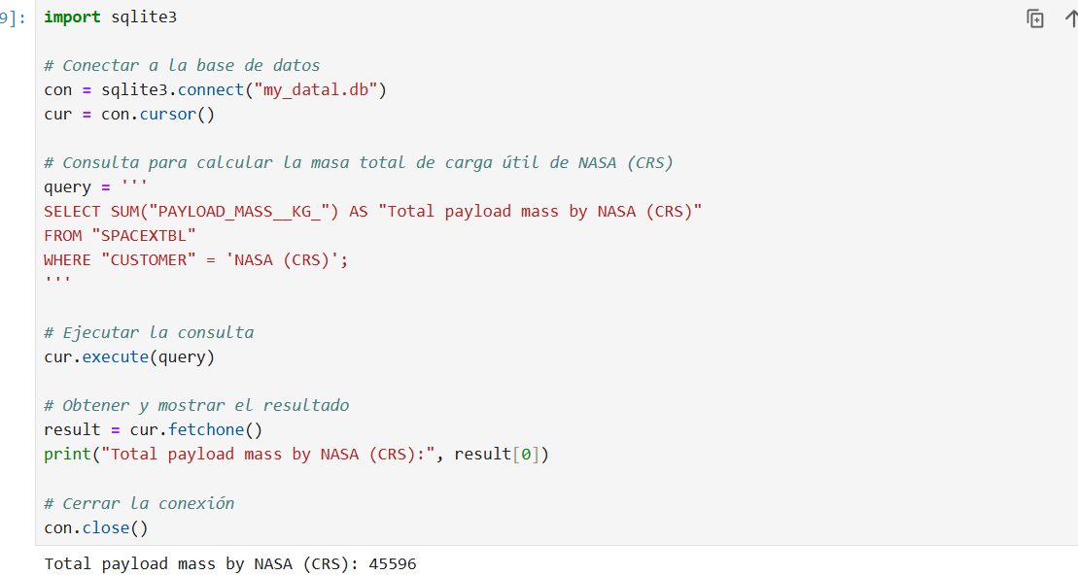
Total Payload Mass

Slide 28
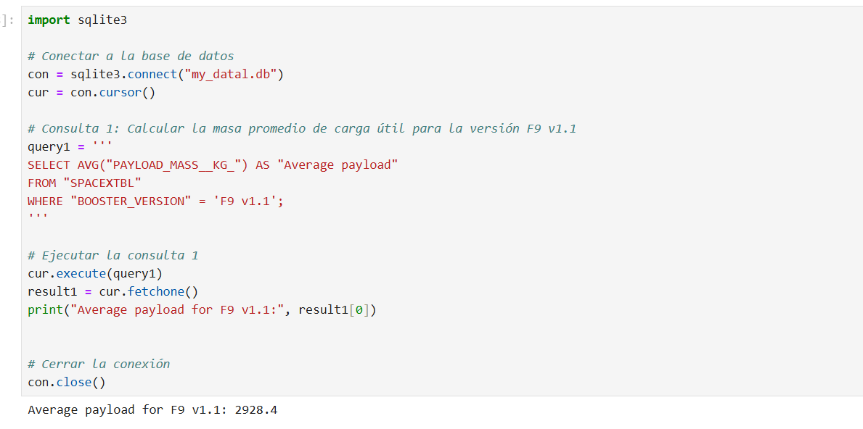
Average Payload Mass by F9 v1.1

Slide 29
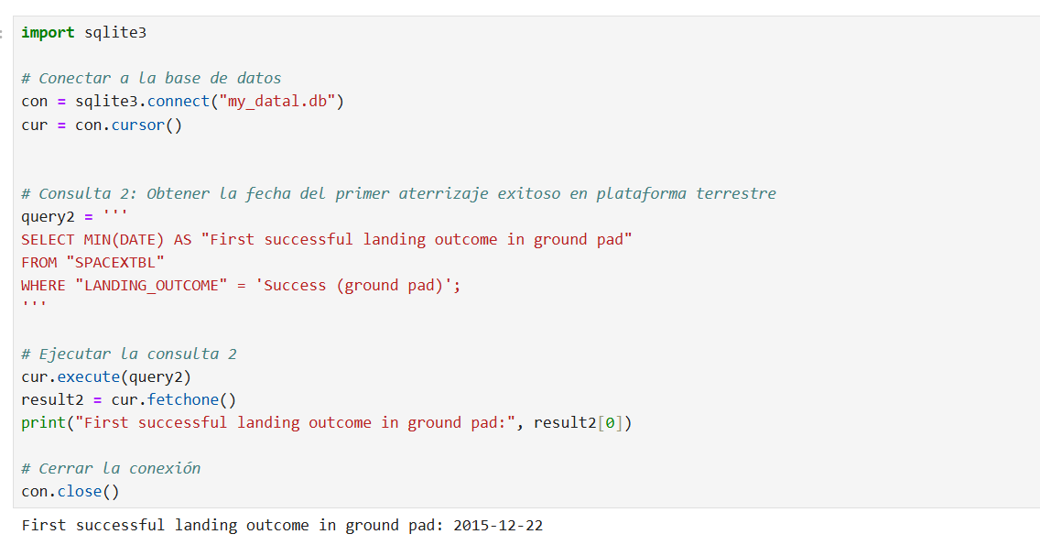
First Successful Ground Landing Date

Slide 30
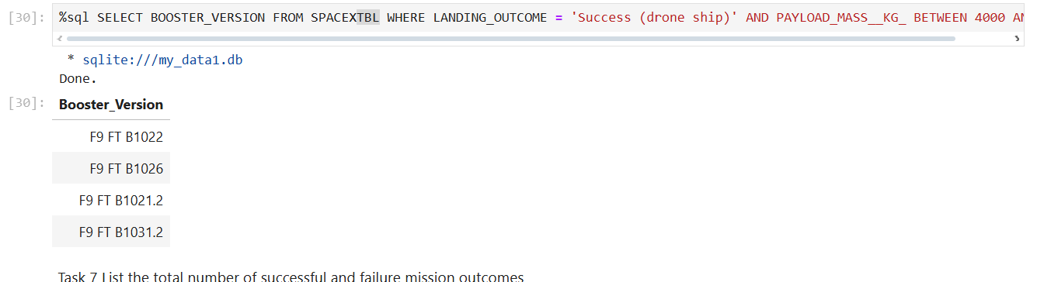
Successful Drone Ship Landing with Payload between 4000 and 6000

Slide 31
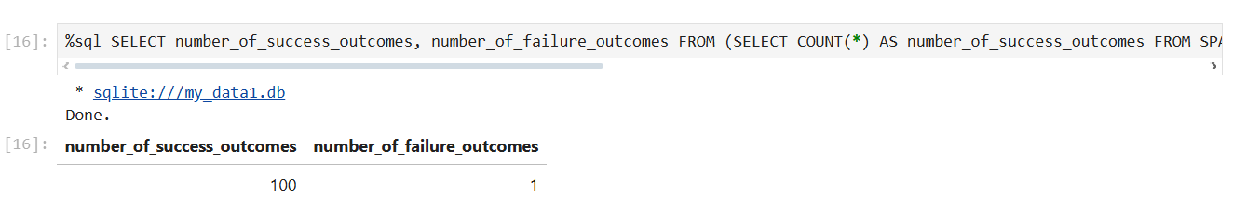
Total Number of Successful and Failure Mission Outcomes

Slide 32
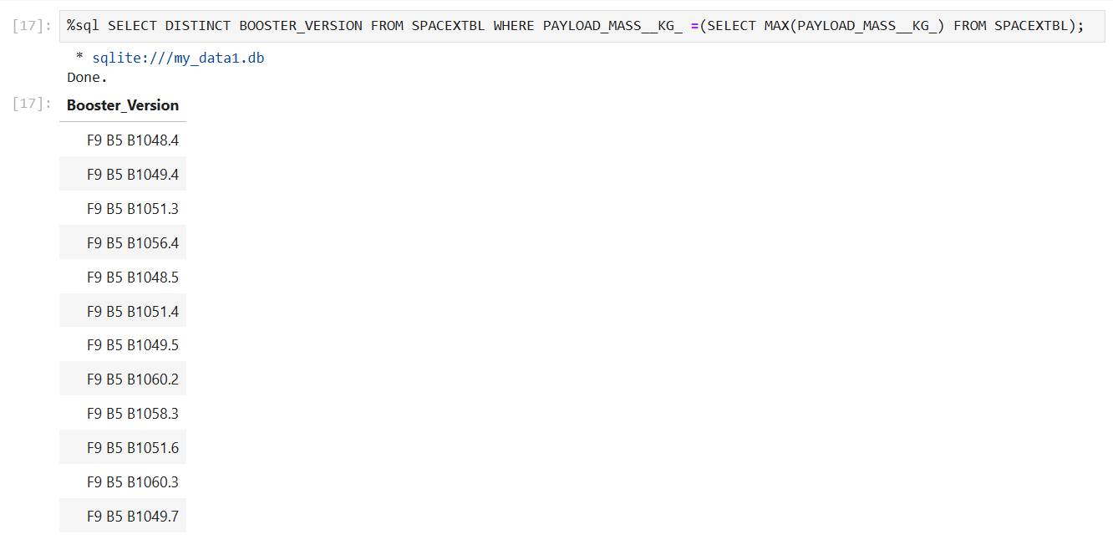
Boosters Carried Maximum Payload

Slide 33
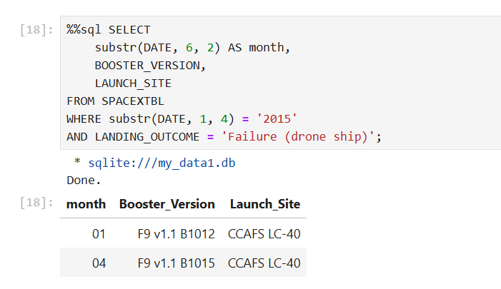
2015 Launch Records

Slide 34
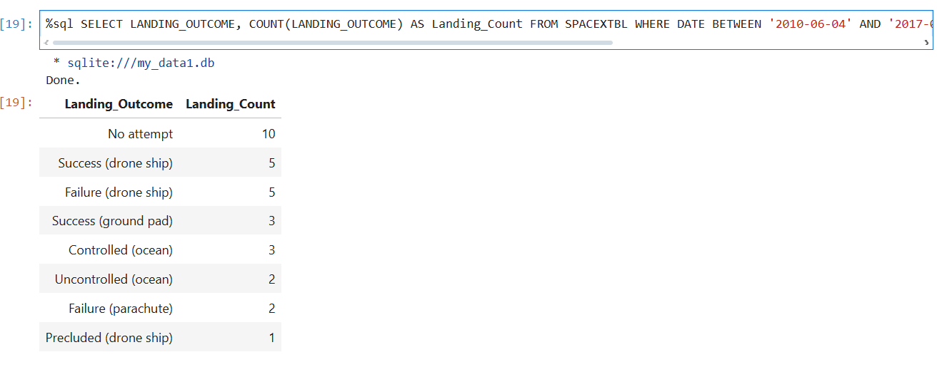
Rank Landing Outcomes Between 2010-06-04 and 2017-03-20

Slide 35

Section 3

Slide 36
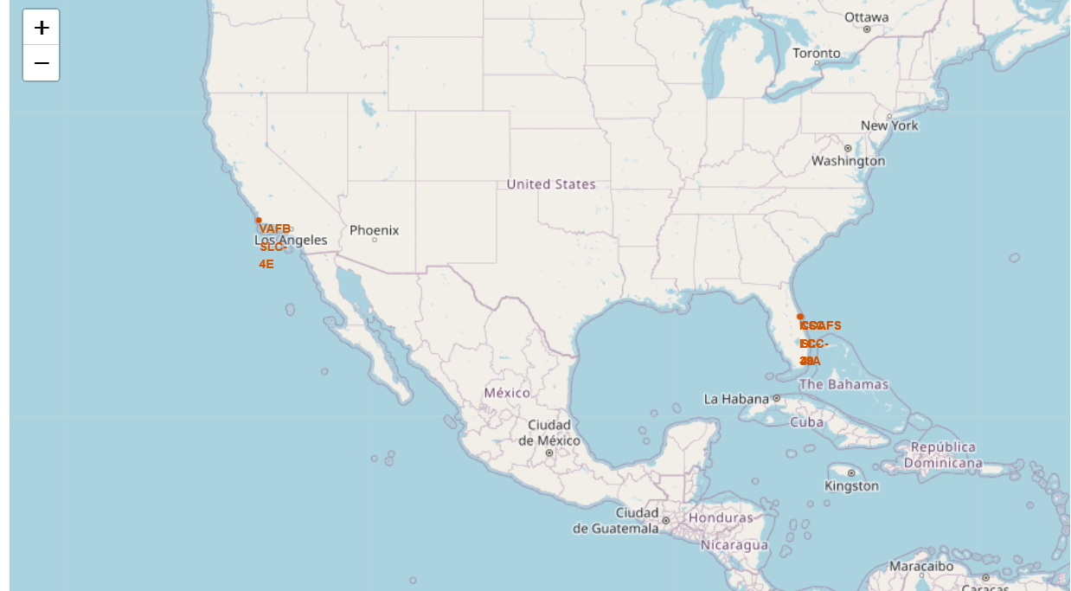
Marked launch sites locations on a global map

Slide 37
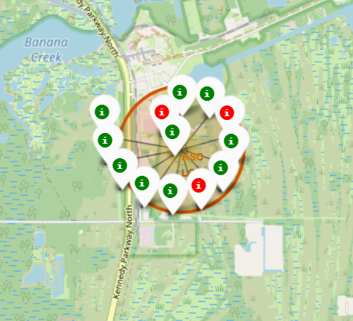
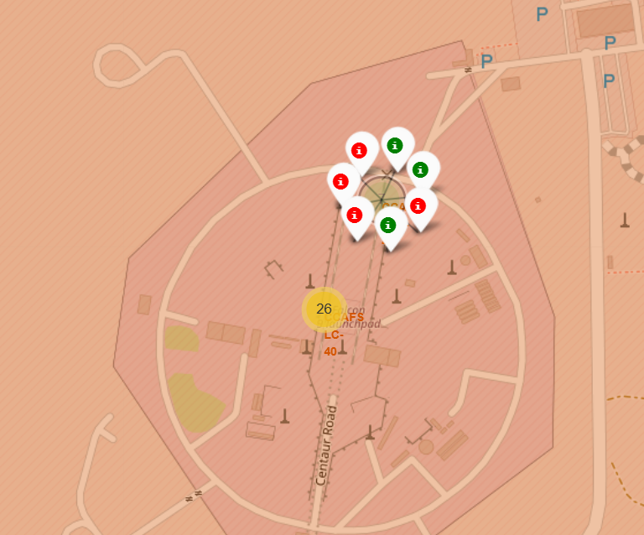
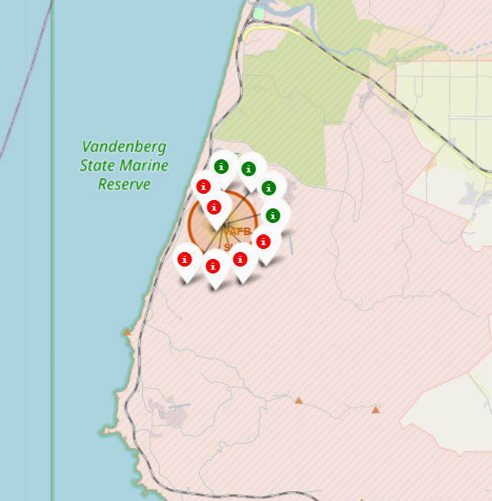
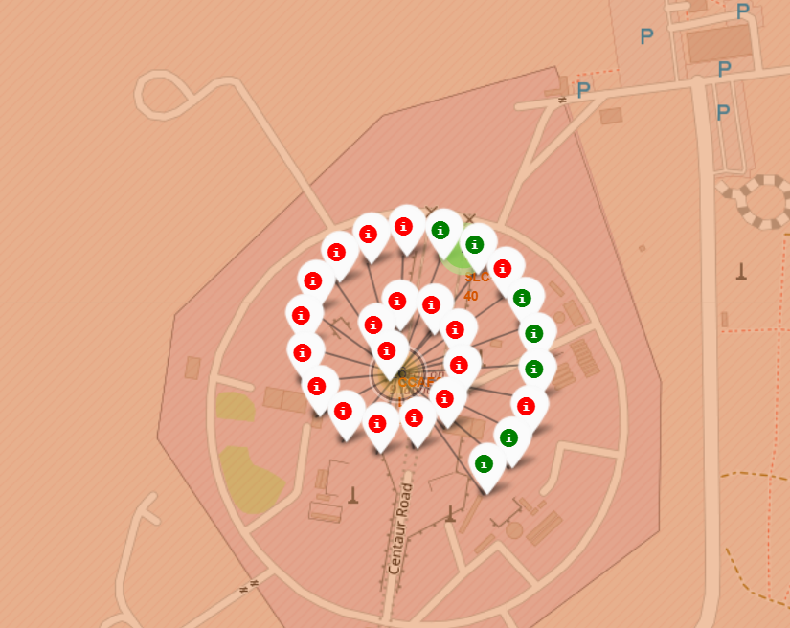
Launch records on the map (successful and unsuccessful)

Slide 38
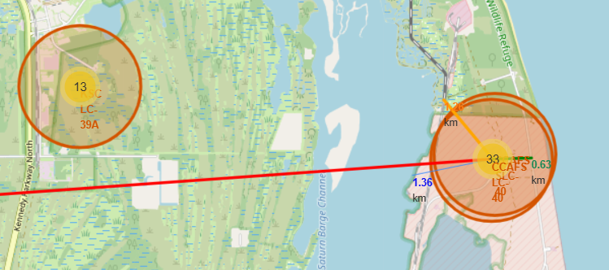
Distance from the Launch Site

Slide 39

Section 4

Slide 40
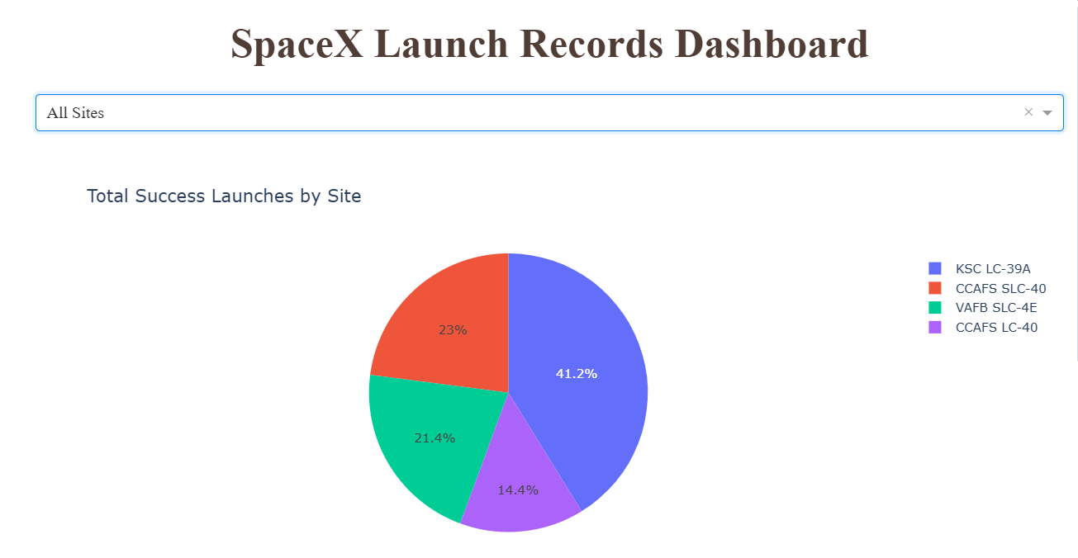
Distribution of successful launch sites

Slide 41
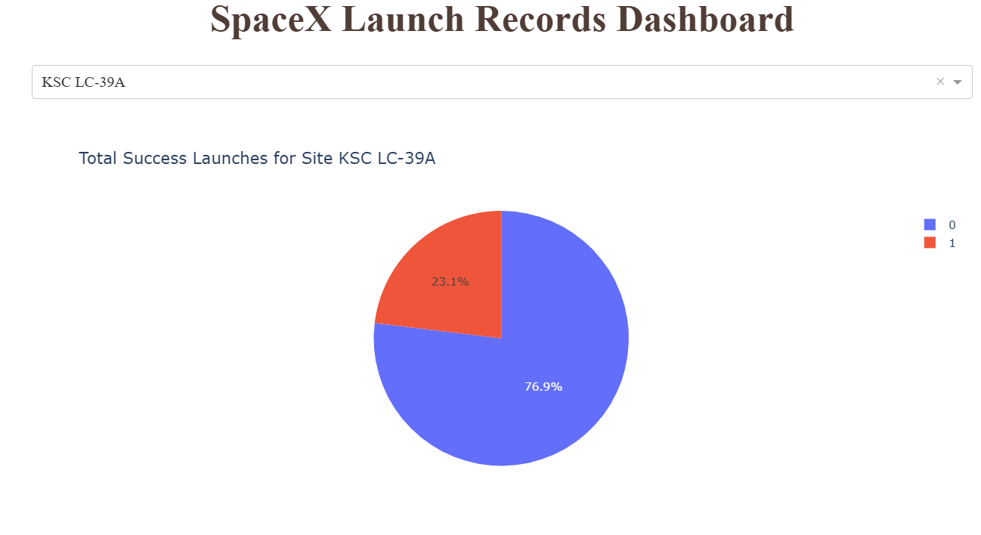
KSC LC-39A is the launch site with highest launch success ratio

Slide 42
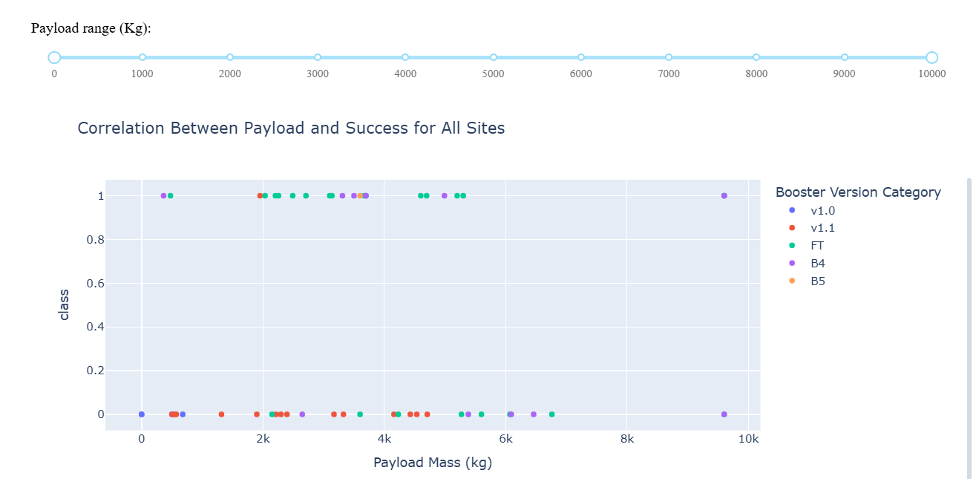
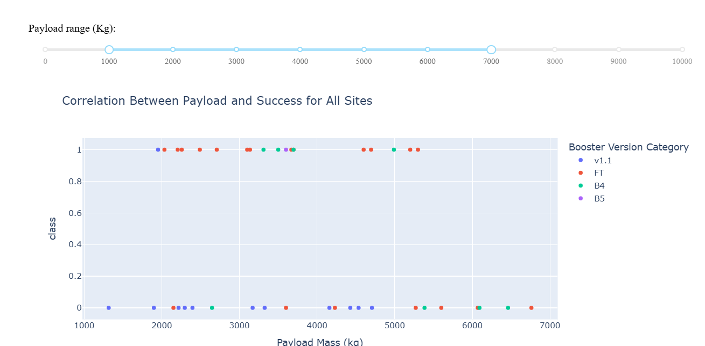
Payload vs Launch Outcome Scatter Plot

Slide 43

Section 5

Slide 44
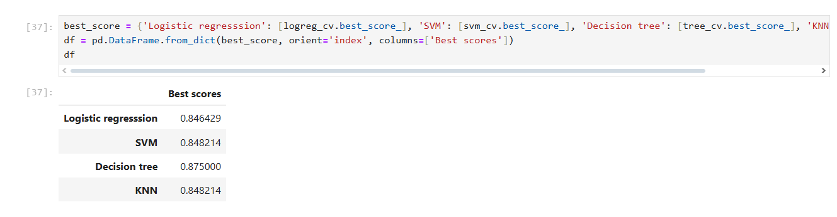
Classification Accuracy
Decision Tree Algorithm has the highest classification accuracy with 0.8750

Slide 45
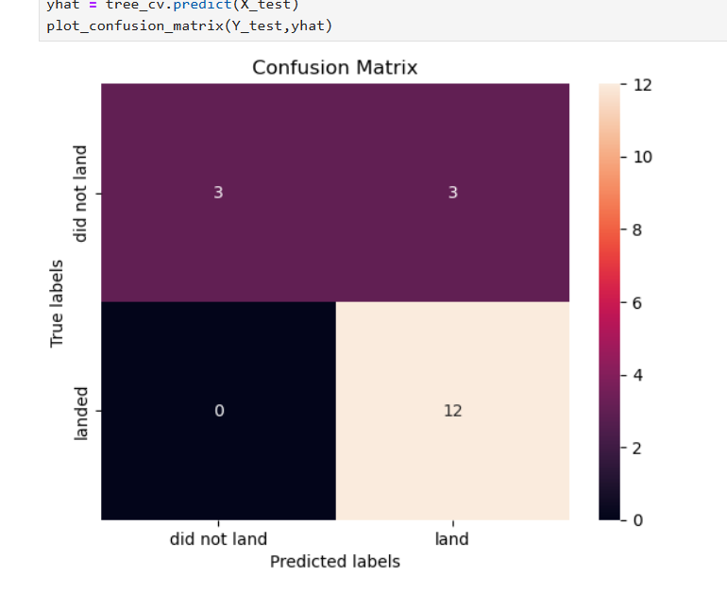
Confusion Matrix
Main conclusion: The Decision Tree model is able to distinguish between the different classes.
Problem identified: The biggest challenge is false positives.

Slide 46
Conclusions
Best model: Decision Tree is the most accurate for this data set.
Success rate by payload mass: Launches with light payloads (≤ 4000 kg) have higher success rate.
Time trend: SpaceX's success rate has steadily increased since 2013, trending upward toward 2020 and beyond.
Most successful launch site: KSC LC-39A has the highest success rate (76.9%).
Most consistent orbit: SSO orbit has 100% success rate across multiple launches.
Location of launch sites: Most are near the equator and coast, minimizing risks.

Slide 47


